Slide 1
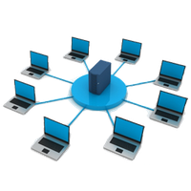
Network Professional
ACCESS MORE COURSES PLAYLIST LINK IN DESCRIPTION
BEGINNER TO EXPERT GUARANTEED

Slide 2
Networking Basics
Network Types
Network Topologies
Network Devices
Transmission Modes
Digital Transmission
Transmission Media
How Internet Works
IP Addressing IPv4 & IPv6
Subnet Mask, MAC, DHCP & DNS
WLAN & WPAN Networks
OSI Model
TCP/IP Model
TCP & UDP
ARP & RARP
CSMA/CA & CSMA/CD
Proxy & VPN
Server & Datacenter
Topics going to Cover

Slide 3
19. Network Security
20. NAS & NAT
21. RAID (Redundant Array of Independent Disk)
22. Sharing Folder in Network
23. TELNET in Network
24. Remote Desktop Connection
25. Windows Remote Assistance
26. FTP in Network
27. Configuring Network
28. Configuring Router
29. Protocols You need to know
30. Networking Commands you must know
Topics going to Cover

Slide 4

1.
Networking Basics

Slide 5
Network?
A network consists of two or more computers that are linked in order to share resources, exchange files or communication.The computers on a network may be linked through cables, telephone lines, radio waves, satellites, or infrared light beams.

Slide 6
Networking?
Networking, also known as computer networking, is the practice of transporting and exchanging data or information & having communication between connected nodes over a shared medium.

Slide 7
Internet?
Collection of Networks is Internet. The first workable prototype of the Internet came in the late 1960s with the creation of ARPANET, or the Advanced Research Projects Agency Network. Which was designed for US defence. Later Sir Tim berners lee introduced WWW cocept and starts web.

Slide 8
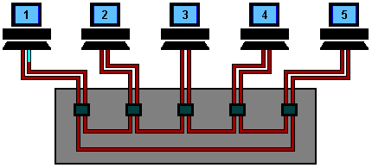
Message or Token?
When one of the systems on the network has the "token," it can send information to the other computers. Since there is only one token for each token-ring network, only one computer can send data at a time. It verify that the target reciever is present or not before sending the data from sender.

Slide 9
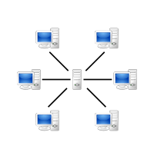
Architecture
Peer to Peer Model

Slide 10

Architecture
Client-Server Model

Slide 11

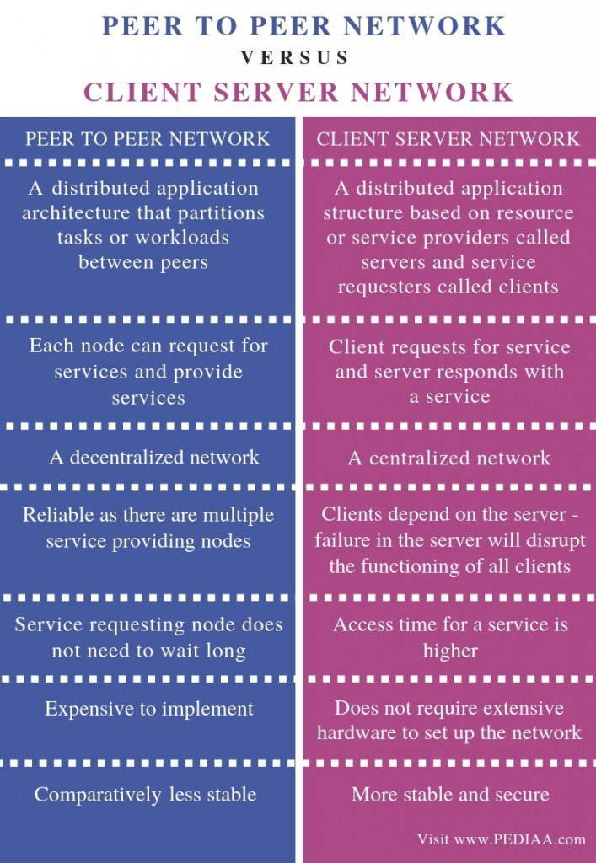
Peer to Peer VS Client-Server Model

Slide 12
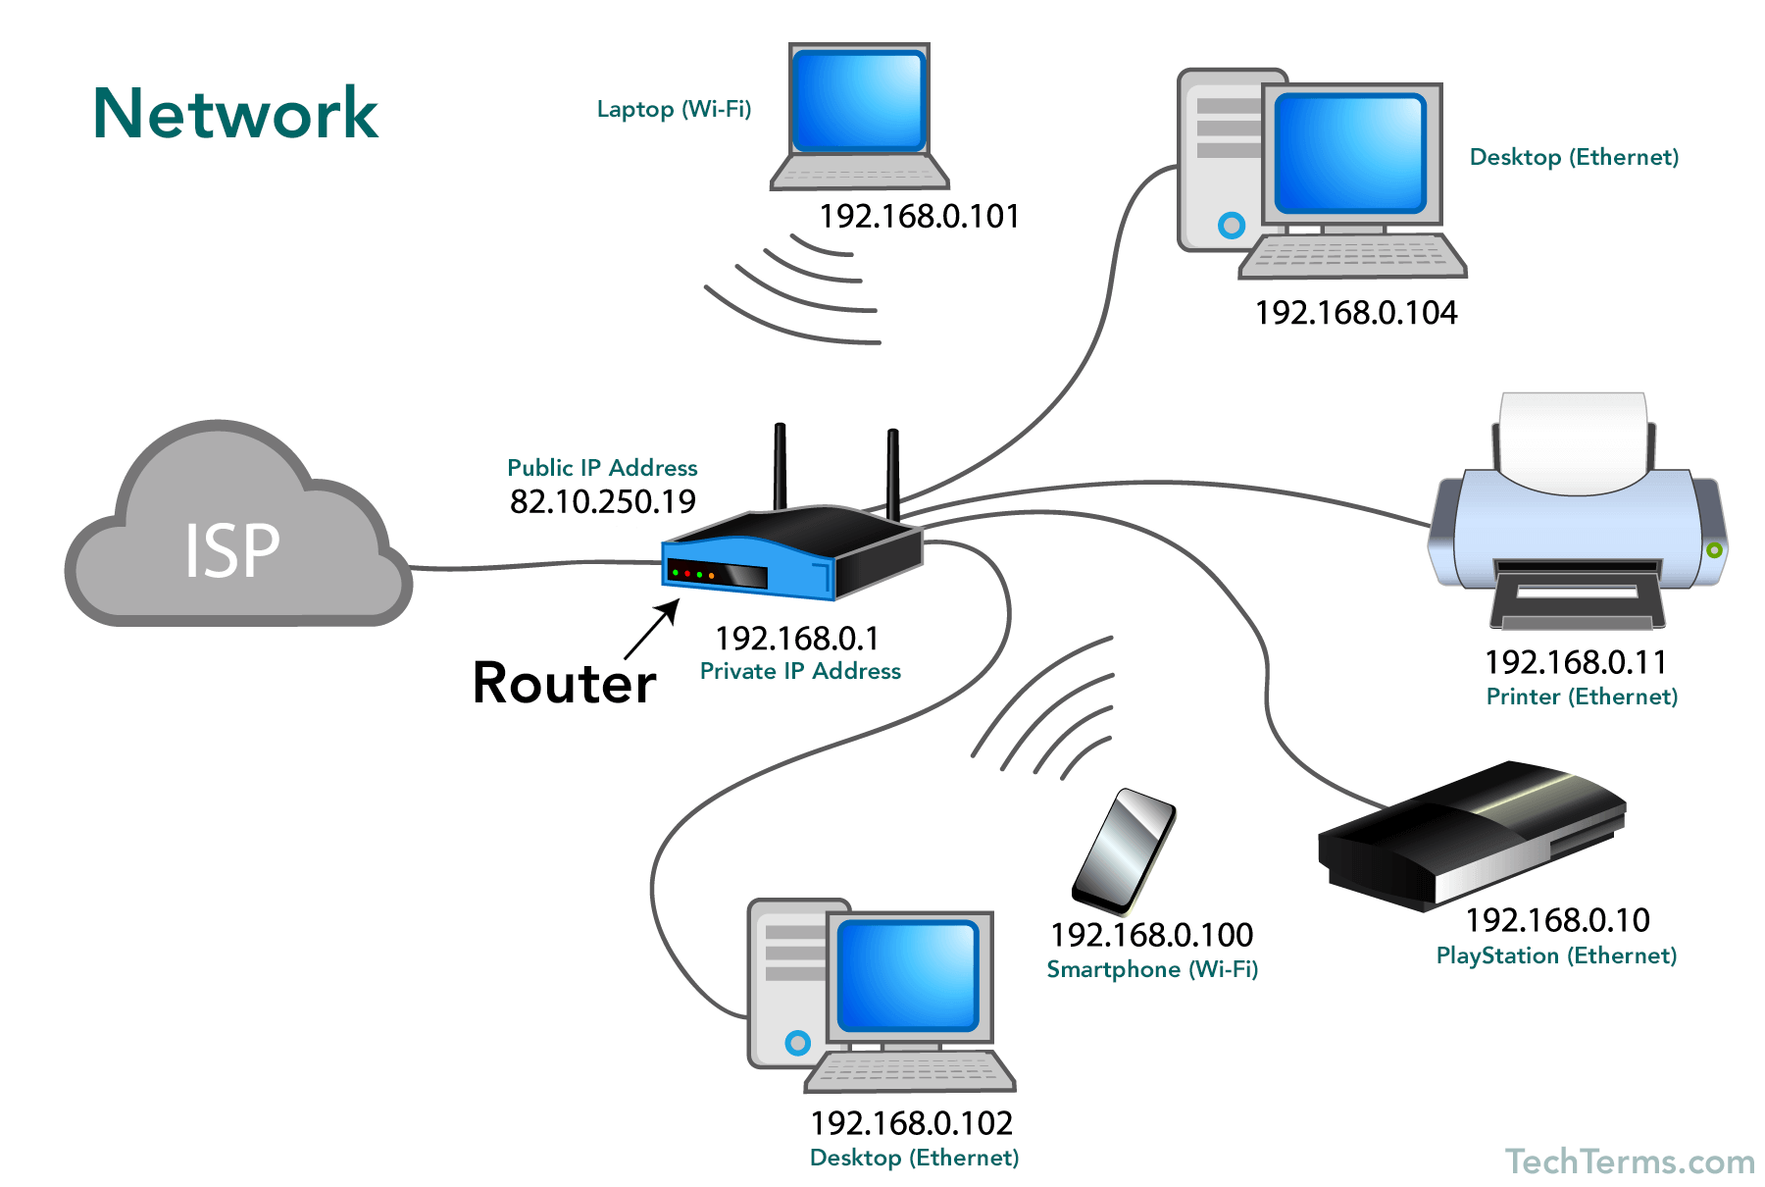

Slide 13
2.
Network Types

Slide 14
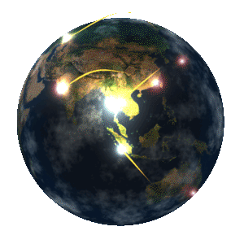
Basic Types of Networks
Personal Area Network (PAN)
Local Area Network (LAN)
Wide Area Network (WAN)
Wireless Local Area Network (WLAN)
Campus Area Network (CAN)
Metropolitan Area Network (MAN)
Storage Area Network (SAN)
Enterprise Private Network (EPN)
Virtual Private Network (VPN)

Slide 15
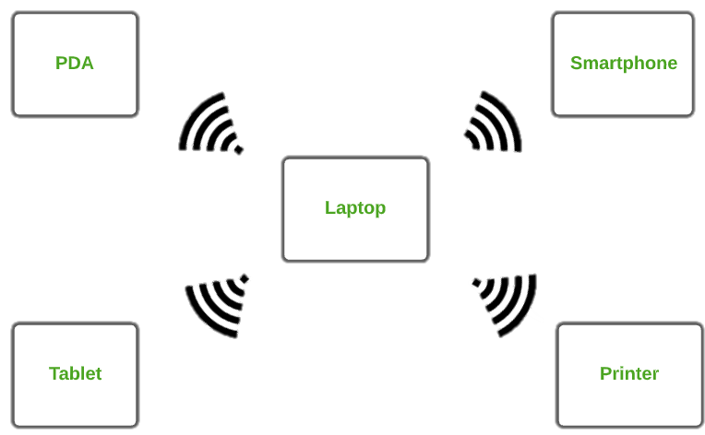
1. Personal Area Network (PAN)
PAN is the most basic type of computer network. This network is restrained to a single person, PAN offers a network range of 10 meters from a person to the device providing communication.

Slide 16
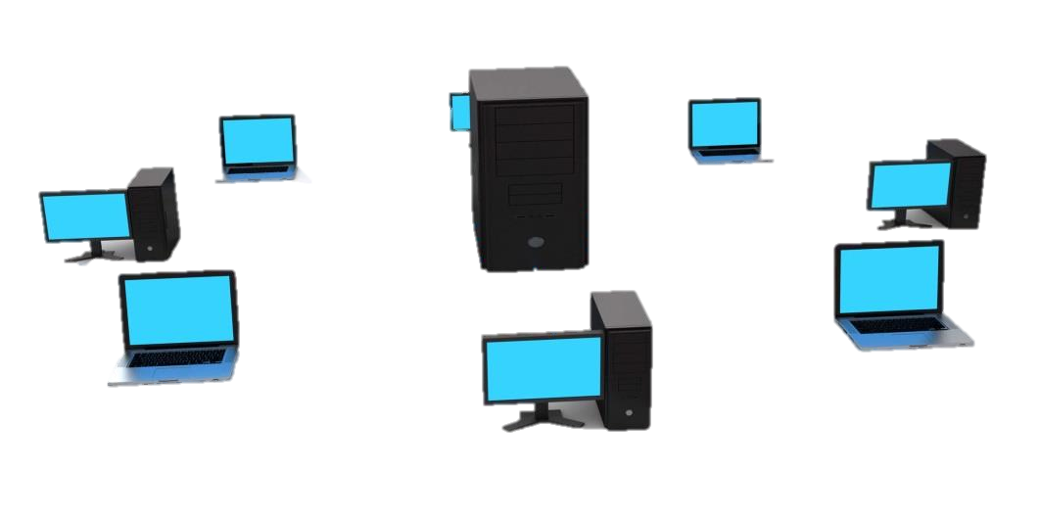
2. Local Area Network (LAN)
LAN is the most frequently used network. A LAN is a computer network that connects computers together through a common communication path, contained within a limited area, A LAN encompasses two or more computers connected over a server. The two important technologies involved in this network are Ethernet and Wi-fi.

Slide 17
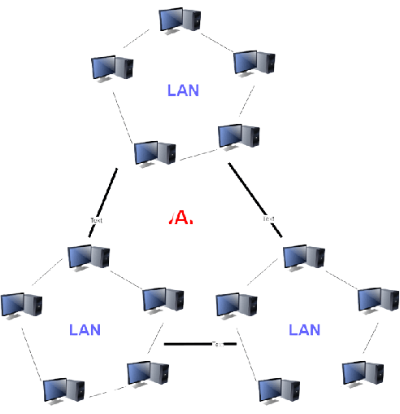
3. Wide Area Network (WAN)
WAN is a type of computer network that connects computers over a large geographical distance through a shared communication path. It is not restrained to a single location but extends over many locations. WAN can also be defined as a group of local area networks that communicate with each other.
WAN

Slide 18
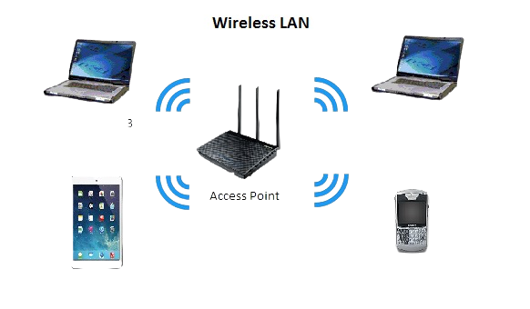
4. Wireless Local Area Network (WLAN)
WLAN is a type of computer network that acts as a local area network but makes use of wireless network technology like Wi-Fi. This network doesn’t allow devices communicating over physical cables like in LAN, but allows devices to communicate wirelessly.

Slide 19
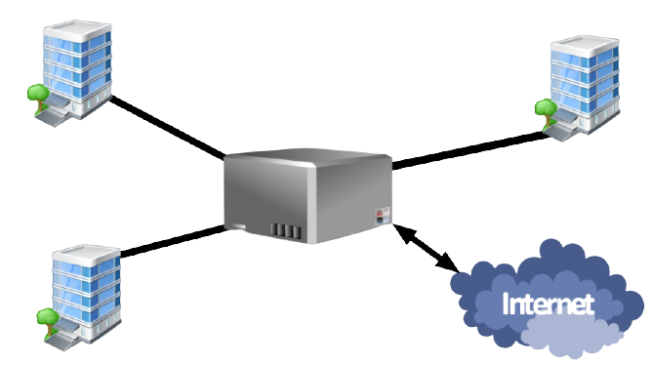
5. Campus Area Network (CAN)
CAN is bigger than a LAN but smaller than a MAN. This is a type of computer network which is usually used in places like a school or college. This network covers a limited geographical area that is, it spreads across several buildings within the campus.

Slide 20
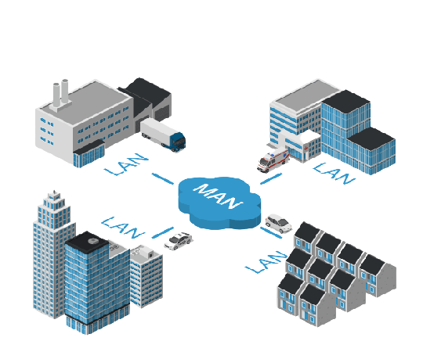
6. Metropolitan Area Network (MAN)
A MAN is larger than a LAN but smaller than a WAN. This is the type of computer network that connects computers over a geographical distance through a shared communication path over a city, town or metropolitan area.

Slide 21
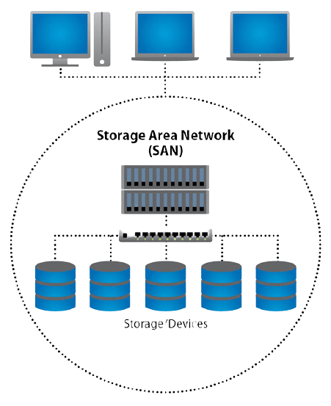
7. Storage Area Network (SAN)
SAN is an abbreviation of the Storage Area Network. Storage Area Network is a dedicated, specialized, and high-speed network which provides block-level data storage. It delivers the shared pool of storage devices to more than one server.

Slide 22
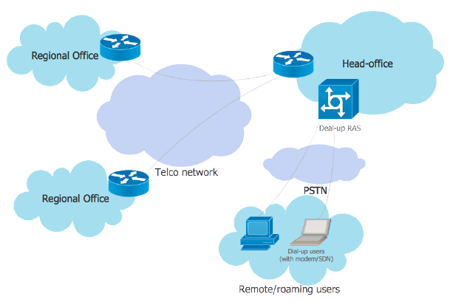
8. Enterprises Private Network (EPN)
EPN is a type of computer network mostly used by businesses that want a secure connection over various locations to share computer resources.

Slide 23
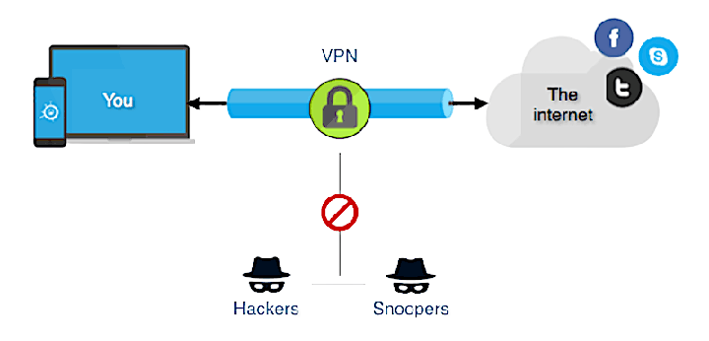
9. Virtual Private Network (VPN)
A virtual private network extends a private network across a public network and enables users to send and receive data across shared or public networks as if their computing devices were directly connected to the private network.

Slide 24
3.
Network Topologies

Slide 25

Basic Types of Network Topologies
Bus Topology
Star Topology
Ring Topology
Tree Topology
Mesh Topology
Hybrid Topology
Daisy Chain Topology

Slide 26
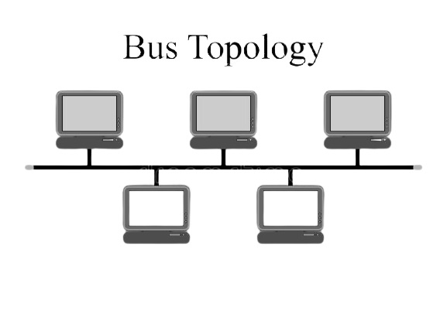
1. Bus Topology
The bus topology is designed in such a way that all the stations are connected through a single cable known as a backbone cable. The backbone cable is considered as a "single lane" through which the message is broadcast to all the stations.

Slide 27
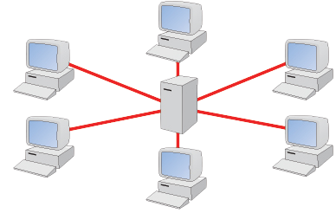
2. Star Topology
Star topology is an arrangement of the network in which every node is connected to the central hub, switch or a central computer. The central computer is known as a server, and the peripheral devices attached to the server are known as clients.

Slide 28
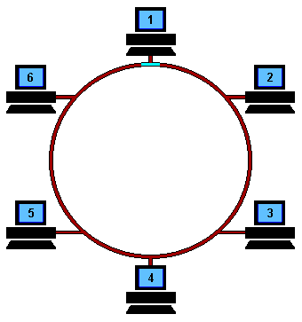
3. Ring Topology
Ring topology is like a bus topology, but with connected ends. The node that receives the message from the previous computer will retransmit to the next node.
The data flows in a single loop continuously known as an endless loop. The most common access method of the ring topology is token passing.

Slide 29
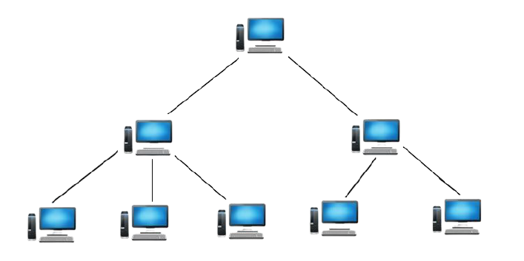
4. Tree Topology
Tree topology combines the characteristics of bus topology and star topology. A tree topology is a type of structure in which all the computers are connected with each other in hierarchical fashion. If the central hub gets fails the entire system fails.

Slide 30
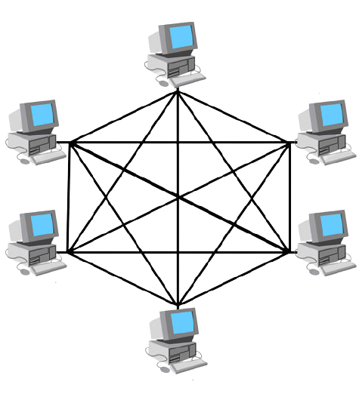
5. Mesh Topology
In this type of topology, a host is connected to one or multiple hosts.This topology has hosts in point-to-point connection with every other host or may also have hosts which are in point-to-point connection to few hosts only.
Two types Full Mesh Topology & Partially Mesh.

Slide 31
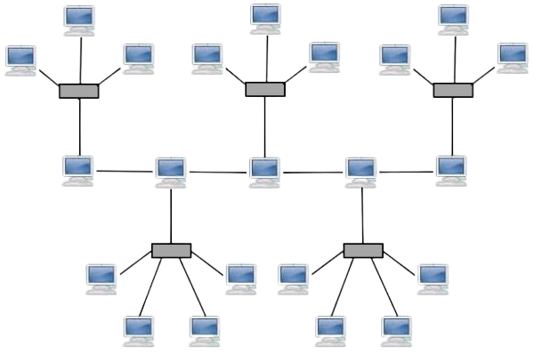
6. Hybrid Topology
The combination of various different topologies is known as Hybrid topology. When two or more different topologies are combined together is termed as Hybrid topology and if similar topologies are connected with each other will not result in Hybrid topology.

Slide 32
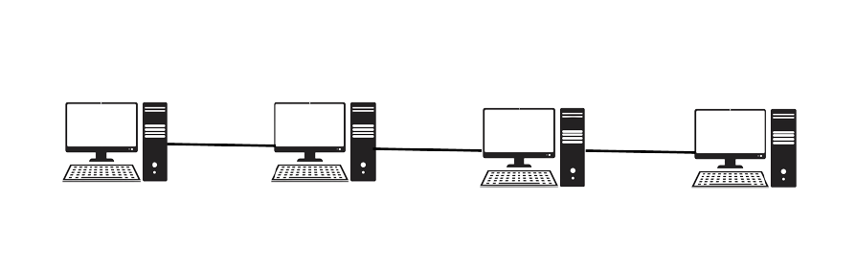
7. Daisy Chain Topology
This topology connects all the hosts in a linear fashion. Similar to Ring topology, all hosts are connected to two hosts only, except the end hosts.Means, if the end hosts in daisy chain are connected then it represents Ring topology.

Slide 33
4.
Network Devices

Slide 34

Basic Types of Network Devices
NIC Card
Hub
Switch
Router
Repeater
Modem
Bridge
Gateway
Access Point
Server

Slide 35
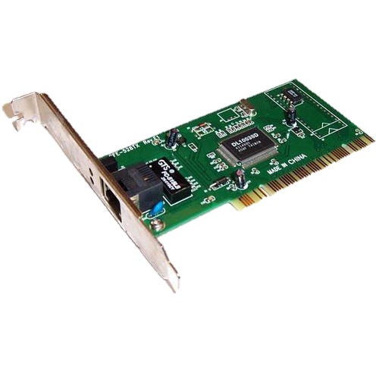
1. NIC Card
NIC or network interface card is a network adapter that is used to connect the computer to the network.bIt has a unique id that is written on the chip, and it has a connector to connect the cable to it. The cable acts as an interface between the computer and router.

Slide 36
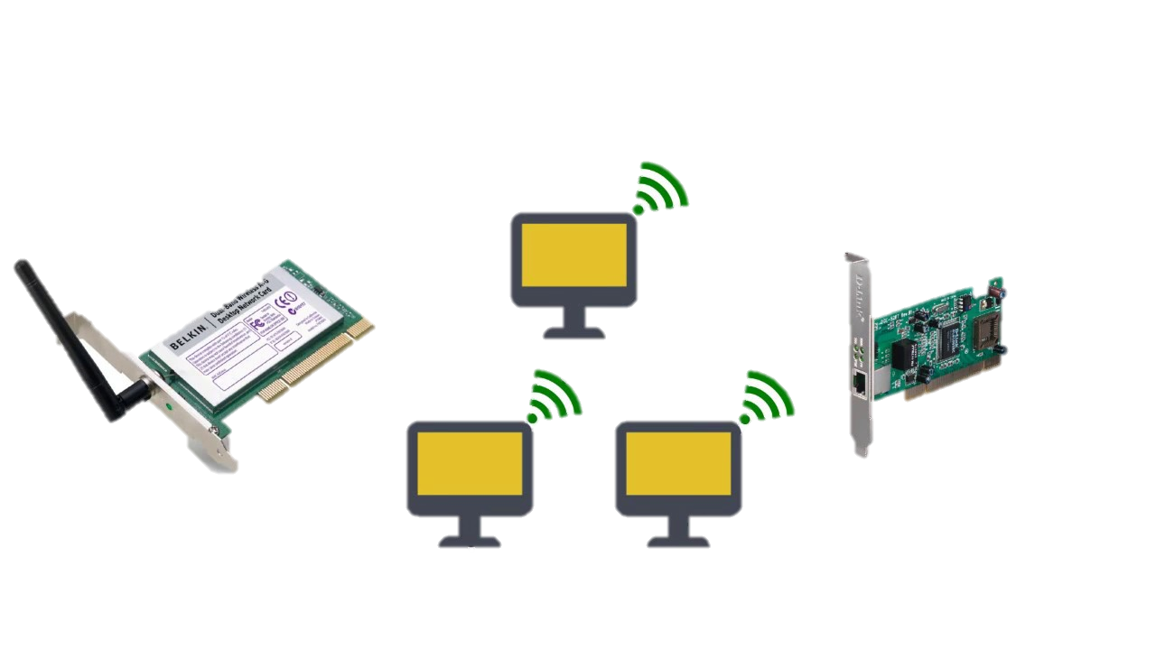
NIC Card
Wireless NIC
Wired NIC

Slide 37
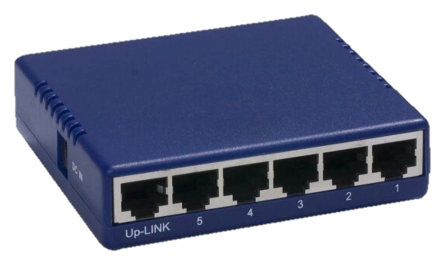
2. Hub
A hub is basically a multiport repeater. A hub connects multiple wires coming from different branches, for example, the connector in star topology which connects different stations. Hubs cannot filter data, so data packets are sent to all connected devices. they do not have the intelligence to find out the best path for data packets which leads to inefficiencies and wastage.

Slide 38
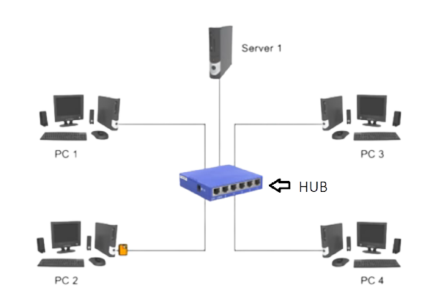
Hub

Slide 39
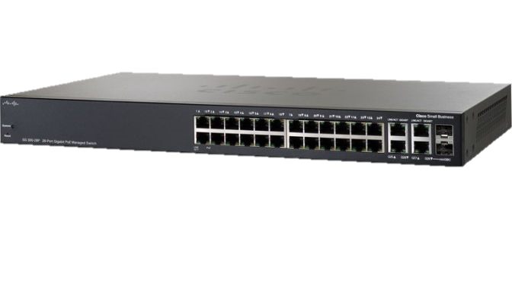
3. Switch
A switch is a hardware device that connects multiple devices on a computer network. A Switch contains more advanced features than Hub. A Switch does not broadcast the message to the entire network like Hub. It determines the device to whom the message is to be transmitted. Therefore, we can say that switch provides a direct connection between the source and destination. It increases the speed of the network.

Slide 40
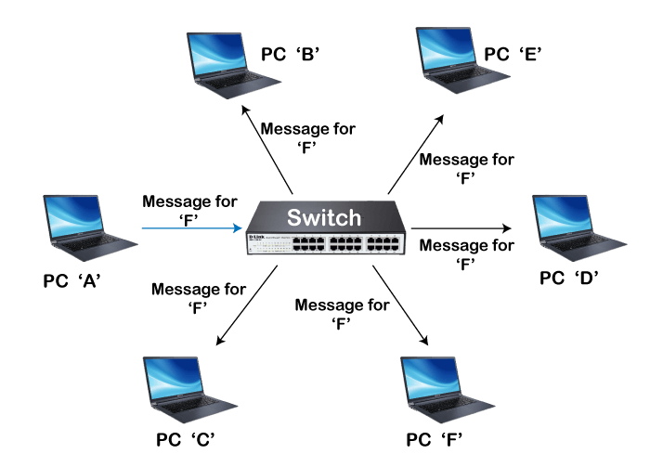
Switch

Slide 41
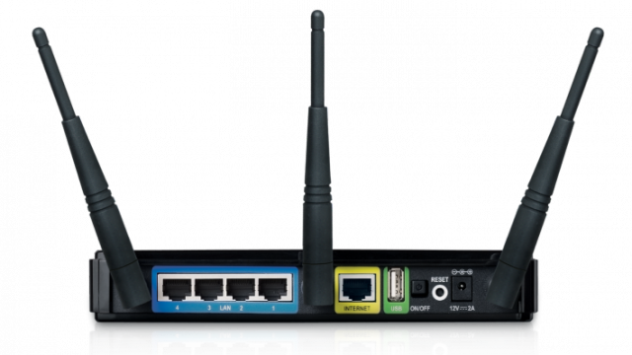
4. Router
A router is a device like a switch that routes data packets based on their IP addresses. It is used to receive, analyze and forward the incoming packets to another network. A router forwards the packet based on the information available in the routing table.

Slide 42
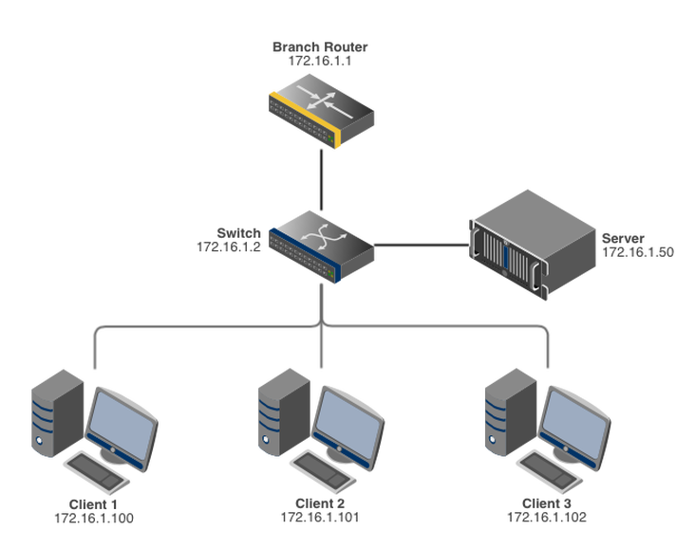
Router

Slide 43
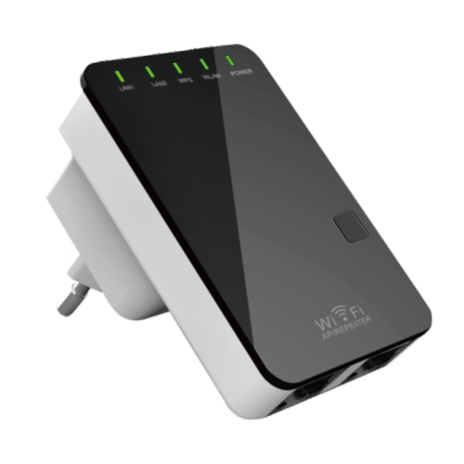
5. Repeater
Its job is to regenerate the signal over the same network before the signal becomes too weak or corrupted so as to extend the length to which the signal can be transmitted over the same network. An important point to be noted about repeaters is that they do not amplify the signal. When the signal becomes weak, they copy the signal bit by bit and regenerate it at the original strength.

Slide 44
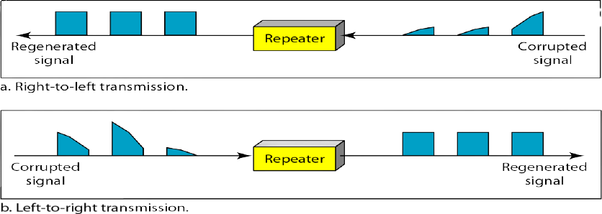
Repeater

Slide 45
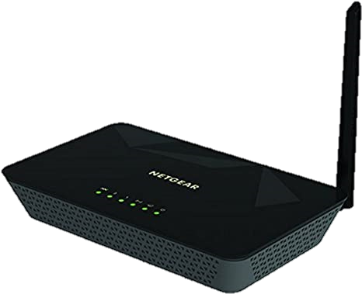
6. Modem
It stands for Modulator/Demodulator. It converts the digital data into an analog signal over the telephone lines. It allows the computer to connect to the internet over the existing telephone line.
Standard PC modem or Dial-up modem
Cellular Modem
Cable modem

Slide 46
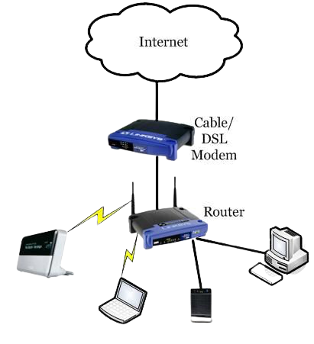
Modem

Slide 47
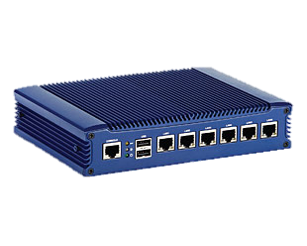
7. Bridge
A bridge is a repeater, with add on the functionality of filtering content by reading the MAC addresses of source and destination. It is also used for interconnecting two LANs working on the same protocol. It has a single input and single output port.

Slide 48
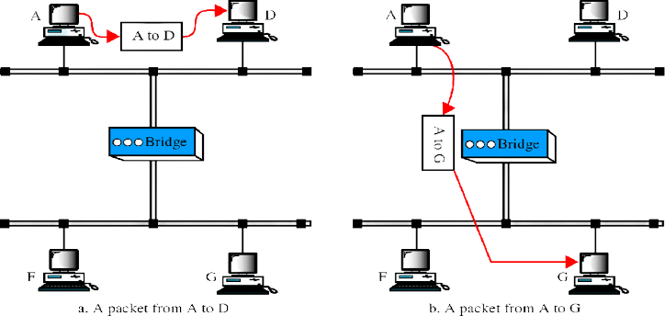
Bridge

Slide 49
Types of Bridges
Transparent Bridge :-
Translational Bridge :-
Source Routing Bridge :-
Remote type Bridge :-
These are the bridge in which the stations are completely unaware of the bridge’s existence
A type of bridge that interconnects two different types of LAN protocols, such as Ethernet and Token Ring.
A type of bridge that interconnects 2 different types of LAN protocols, such as Ethernet and Token Ring.
A device that connects two LAN segments together that are in geographically dispersed locations. It connects LANs via a WAN.

Slide 50
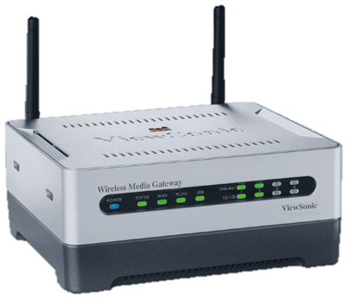
8. Gateway
A gateway is a network node that forms a passage between two networks operating with different transmission protocols.
The gateway converts information, data or other communications from one protocol or format to another. A router may perform some of the functions of a gateway.

Slide 51
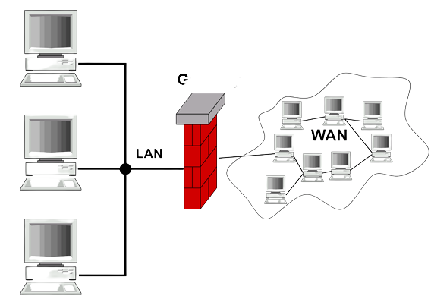
Gateway

Slide 52
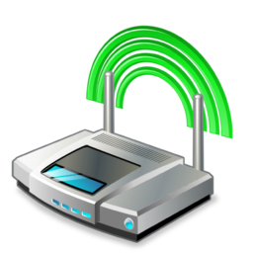
9. Access Point
An access point is a device that creates a wireless local area network, or WLAN, usually in an office or large building. An access point connects to a wired router, switch, or hub via an Ethernet cable and device that allows other Wi-Fi devices to connect to a wired network.

Slide 53
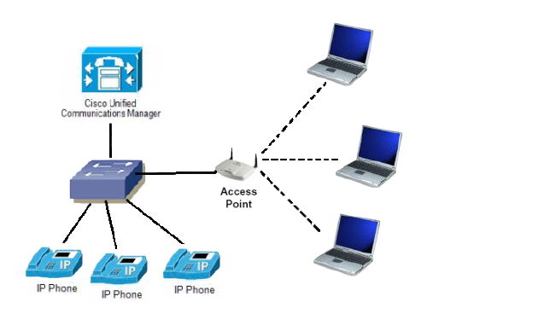
Access Point

Slide 54
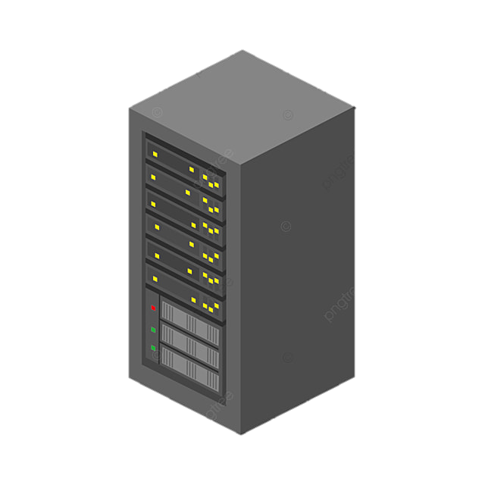
10. Server
A server is a computer or system that provides resources, data, services, or programs to other computers, known as clients, over a network. In theory, whenever computers share resources with client machines they are considered servers. Typical servers are database servers, file servers, mail servers, print servers, web servers, game servers, and application servers.

Slide 55
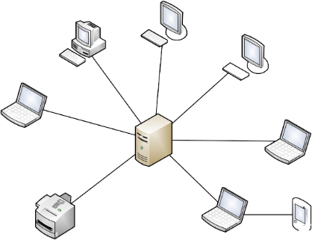
Server

Slide 56
5.
Transmission Modes

Slide 57
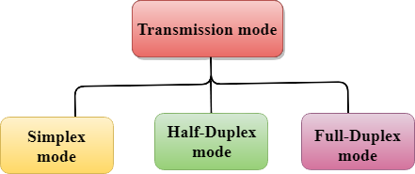
Transmission Mode?
The way in which data is transmitted from one device to another device is known as transmission mode. Each communication channel has a direction associated with it, and transmission media provide the direction. Therefore, the transmission mode is also known as a directional mode.

Slide 58
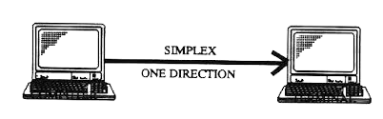
Simplex-mode Transmission
In Simplex mode, the data flows in one direction. This transmission mode is not very popular as mainly communications require the two-way exchange of data. Keyboard and Monitor are the examples of the simplex mode as a keyboard can only accept the data from the user and monitor can only be used to display the data on the screen. The main advantage of the simplex mode is that the full capacity of the communication channel can be utilized during transmission.

Slide 59
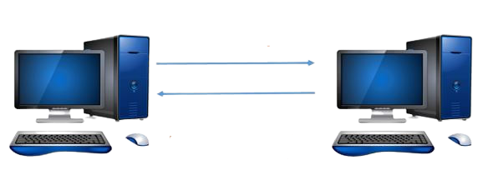
Half-Duplex Transmission
In a Half-duplex channel the station can transmit and receive the data as well. Messages flow in both the directions, but not at the same time. A Walkie-talkie is an example of the Half-duplex mode. In Walkie-talkie, one party speaks, and another party listens. After a pause, the other speaks and first party listens. The entire bandwidth of the communication channel is utilized in one direction at a time.

Slide 60
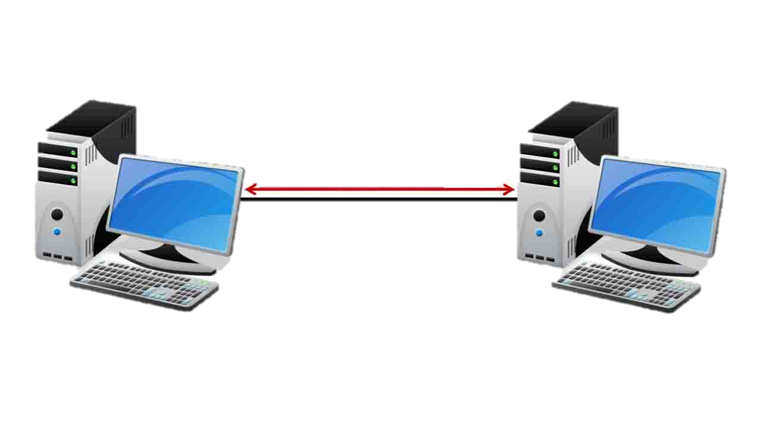
Full-Duplex Transmission
In Full duplex mode, the data flow in both the directions. Both the stations can send and receive the message simultaneously. The Full-duplex mode is the fastest mode of communication between devices. The most common example of the full-duplex mode is a telephone network. When two people are communicating with each other by a telephone line, both can talk and listen at the same time.

Slide 61
6.
Digital Transmission

Slide 62
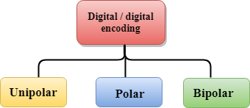
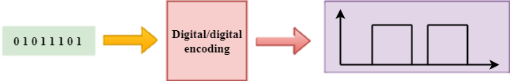
Digital Transmission ?
Data can be represented either in analog or digital form. The computers used the digital form to store the information. Therefore, the data needs to be converted in digital form so that it can be used by a computer.
Digital-to-digital encoding is the representation of digital information by a digital signal. When binary 1s and 0s generated by the computer are translated into a sequence of voltage pulses that can be propagated over a wire, this process is known as digital-to-digital encoding.
Digital to Digital Conversion ?
three categories

Slide 63
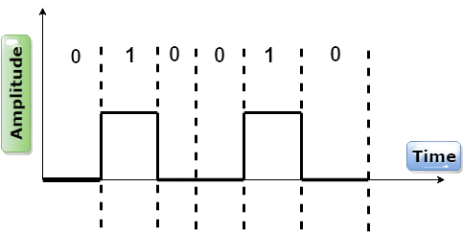
Unipolar
Digital transmission system sends the voltage pulses over the medium link such as wire or cable. The polarity of each pulse determines whether it is positive or negative. In Unipolar Encoding, '1' is considered as a high voltage and '0' is considered as a zero voltage.

Slide 64
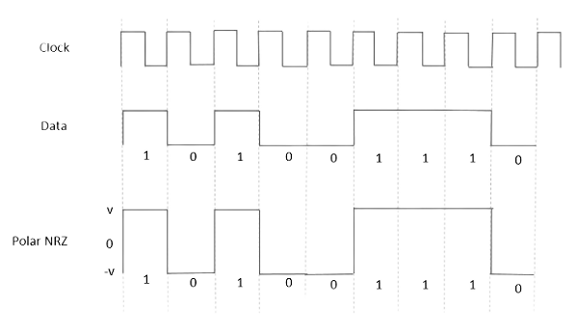

Polar
Polar encoding is an encoding scheme that uses two voltage levels: one is positive, and another is negative. By using two voltage levels, an average voltage level is reduced, and the DC component problem of unipolar encoding scheme is alleviated.
Polar NRZ
Polar RZ
Polar NRZ
Polar RZ

Slide 65

Bipolar
If the first 1 bit is represented by positive amplitude, then the second 1 bit is represented by negative voltage, third 1 bit is represented by the positive amplitude and so on. This alternation can also occur even when the 1bits are not consecutive.
AMI (Alternate Mark Inversion) The Binary 0 gets represented by a neutral voltage. On the other hand, alternating negative and positive voltages represent the Binary 1s.
Pseudoternary Here, we encode the bit 1 as a zero voltage, while we encode the bit 0 as alternating negative and positive voltages. It means that this one is exactly the opposite of the AMI scheme. For example, Data = 010010.

Slide 66
7.
Transmission Media

Slide 67

Transmission Media?
Transmission media is a communication channel that carries the information from the sender to the receiver. Data is transmitted through the electromagnetic signals.
Bandwidth :-
The greater the bandwidth of a medium, the higher the data transmission rate of a signal.
Transmission impairment :- When the received signal is not identical to the transmitted one due to the transmission impairment. quality of the signals will get destroyed due to transmission impairment.
Interference :- An interference is defined as the process of disrupting a signal when it travels over a communication medium on the addition of some unwanted signal.
Attenuation means the loss of energy, strength of the signal decreases with increasing the distance
Distortion occurs when there is a change in the shape of signal. This type of distortion is examined from different signals having diff frequencies.
Noise is When data is travelled over a transmission medium, some unwanted signal is added to it

Slide 68

Classification of Transmission Media?
(Guided Media)
(Unguided Media)

Slide 69



Guided Media
It is defined as the physical medium in which the signals are transmitted. also known as Bounded media.
Twisted pair
Co-axial
Fibre Optic
STP
UTP

Slide 70

What is a Cable?
An electrical cable is an assembly of one or more wires running side by side or bundled, which is used to carry electric current. A cable assembly is the composition of one or more electrical cables and their corresponding connectors.

Slide 71




1. Twisted Pair Cable
Twisted-pair cable is a type of cabling that is used for telephone communications and most modern Ethernet networks. A pair of wires forms a circuit that can transmit data. The pairs are twisted to provide protection against crosstalk, the noise generated by adjacent pairs having RJ-11 & RJ-45 Jacks.
Two Types :-
STP (Shielded Twisted Pair Cable)
UTP (Unshielded Twisted Pair Cable)
Ethernet Port
Connects to a network and high speed Internet upto 100baseT.
Known as RJ-45 Port which use RJ-45 Jack as Interface
This port resides on an Ethernet Card.

Slide 72



What are RJ connectors?
RJ Connectors are a family of push-and-click connectors for twisted-pair wiring in telephone and network wiring. RJ stands for Registered Jack. RJ types define both a jack or receptacle (female) and a plug (male) type of connector.
The most common types of RJ connectors are as follows:
RJ-11 connector: A 4-wire or 6-wire telephone-type connector
RJ-45 connector: An 8-wire telephone-type connector
RJ-48 connector: An 8-wire telephone-type connector

Slide 73


Slide 74


2. Patch Cables
Patch cable is often called a straight through cable. In other words, patch cable does not change or swap along its way. Both ends use the same wiring standard: T-568A or T-568B.

Slide 75

Straight Tip vs Crosstalk

Slide 76

Patch Cables vs. Crossover Cable: When to Use?

Slide 77



Scenario 1: PC to PC
Scenario 2: PC to Switch to PC
Scenario 3: PC to Switch to Switch to PC

Slide 78


3. Coaxial Cable
Coaxial cable is commonly used by cable operators, telephone companies, and internet providers around the world to convey data, video, and voice communications to customers. It has also been used extensively within homes.
BNC Connector
Bayonet Neill–Concelman BNC connector is a series of connectors used for connecting thinnet coaxial cabling to various networking components.

Slide 79


Slide 80



4. Optic Fibre Cable
Fibre optics is a modern technology used mostly in the telecommunication industry to transmit information digitally as pulses of light through strands of fibre made of glass.Also known as Optical fibres, these strands are about the diameter of a human hair follicle. When bundled into an optical fibre cable, they can transmit data in volumes faster than other mediums over really long distances.
Subscriber Connector SC
This Connector is for structural cabling it is used for high speed
And for single mode fibre cabling
Straight Tip ST
This Connector is for structural cabling it is used for high speed
And for Multi mode fibre cabling

Slide 81


Slide 82


Slide 83




Unguided Media
They transmits the electromagnetic waves without using physical medium.it is also known as wireless transmission.
Radio Waves
Micro Waves
Infrared Waves
Terrestrial
Satellite

Slide 84

Radio Waves
Radio waves at lower frequencies can travel through walls whereas higher RF can travel in straight line and bounce back.The power of low frequency waves decreases sharply as they cover long distance. High frequency radio waves have more power. The range in frequencies of radio waves is from 20kHz 300Hz.
.
Applications
television and FM and AM radio broadcasts
military communications
Radio Control Car

Slide 85


Slide 86

Microwaves
Microwaves travel in straight lines, and so the transmitter and receiver stations should be accurately aligned to each other. Microwaves are unidirectional
Micro waves electromagnetic waves having frequency in the range from 1GHz to 1000 GHz.
Applications
Cellular phones
3G, 4G or 5G Network
Satellites
Wireless LAN
Wireless PAN

Slide 87




Slide 88


Infrared
Infrared waves are those between the frequencies 300GHz and 400THz in the electromagnetic spectrum. Their wavelengths are shorter than microwaves but longer than visible light. Infrared propagation is line of sight. Range lies bwtween 300 GHz to 400 THz.
Applications
Remote controls for television, stereos and other appliances.
Wireless modem, keyboard, mouse, printer etc
Night vision systems
Motion detectors
MRI

Slide 89


Slide 90
8.
How Internet Works

Slide 91


Slide 92

1. Satellite

Slide 93

2. Submarine Cables

Slide 94
9.
IP Addressing IPv4 & IPv6

Slide 95

What is IP Address?
An Internet Protocol address is a numerical label assigned to each device connected to a computer network that uses the Internet Protocol for communication. An IP address serves two main functions: host or network interface identification and location addressing.

Slide 96
IP Addressing IPv4
An IP address basically a 32-bit address that uniquely universally defines connection of host or a router to the Internet. IP address is unique.
Introduced by IANA (Internet Assigned Numbers Authority).
32 bit is divided into 4 equal parts of 8-8 bits separated by dotted decimal notation. It is in the range of minimum 0.0.0.0 to 255.255.255.255.
Each 8 bit group is known by OCTET.

Slide 97
Various IP classes
IP has five different classes differentiated by characteristics.
Class-A ranges from 0 to 127
Class-B ranges from 128 to 191
Class-C ranges from 192 to 223
Class-D ranges from 224 to 239
Class-E ranges from 240 to 255
First Octet is defines the class of particular IP e.g. - 128.11.3.31 is follow in class –B
127.0.0.0 to 127.255.255.255 is a range of look back IP.

Slide 98

Class-A
Class A addresses only include IP starting from 1.x.x.x to 126.x.x.x only. The IP range 127.x.x.x is reserved for loopback IP addresses.
The default subnet mask for Class A IP address is 255.0.0.0 which implies that Class A addressing can have 126 networks (2⁷-2) and 16777214 hosts (2²⁴-2).

Slide 99
Class B
Class B IP Addresses range from 128.0.x.x to 191.255.x.x. The default subnet mask for Class B is 255.255.x.x.
Class B has 16384 (2¹⁴) Network addresses and 65534 (2¹⁶-2) Host addresses.

Slide 100
Class C
Class C IP addresses range from 192.0.0.x to 223.255.255.x. The default subnet mask for Class C is 255.255.255.x. Class C gives 2097152 (2²¹) Network addresses and 254 (2⁸-2) Host addresses.

Slide 101
Class-D
Class D has IP address range from 224.0.0.0 to 239.255.255.255. Class D is reserved for Multicasting. In multicasting data is not destined for a particular host, that is why there is no need to extract host address from the IP address, and Class D does not have any subnet mask.

Slide 102
Class-E
This IP Class is reserved for experimental purposes only for R&D or Study. IP addresses in this class ranges from 240.0.0.0 to 255.255.255.254. Like Class D, this class too is not equipped with any subnet mask.

Slide 103
IP Addressing
32 bits
Dotted Decimal
Network
Host
255
255
255
255
Maximum
Notes:
Layer 1 of 3:
Purpose: This figure show the general format of an IP address.
In layer 1, the address is 32 bits with a network and host portion.

Slide 104
IP Addressing
IP Addressing
32 bits
Dotted Decimal
Network
Host
255
255
255
255
Maximum
1
8
9
16
17
24
25
32
11111111
11111111
11111111
11111111
Binary
128 64 32 16 8 4 2 1
128 64 32 16 8 4 2 1
128 64 32 16 8 4 2 1
128 64 32 16 8 4 2 1
Notes:
Layer 3 of 3:
In layer 2, one can convert the address to binary.

Slide 105
IP Addressing
IP Addressing
32 bits
Dotted Decimal
Network
Host
255
255
255
255
Maximum
1
8
9
16
17
24
25
32
11111111
11111111
11111111
11111111
Binary
128 64 32 16 8 4 2 1
128 64 32 16 8 4 2 1
128 64 32 16 8 4 2 1
128 64 32 16 8 4 2 1
Example Decimal
172
16
122
204
10101100
00010000
01111010
11001100
Example Binary
Notes:
Layer 3 of 3:
In layer 3, an example of dotted-decimal format and binary are displayed.
Emphasize: IP address format is dotted-decimal. Dotted-decimal makes it easy to work with IP addresses. However, in this course we will work with the addresses on the bit level, so we will convert these addresses into binary, make changes to them, and convert them back.
The central authority for addresses is the Internet Assigned Numbers Authority.
Note: This most common form of addressing reflects the widely used IP version 4. Faced with the problem of depleting available addresses, Internet Engineering Task Force (IETF) work is under way for a backward-compatible next generation of IP (IPng, also called IP 6).
IP 6 will offer expanded routing and addressing capabilities with 128-bit addresses rather than the 32-bit addressing shown on the graphic. Addresses from both IP versions will coexist. Initial occurrences will probably be at locations with address translator software and firewalls.

Slide 106
IP Address Classes
8 bits
8 bits
8 bits
8 bits
Class A:
Class B:
Class C:
Class D: Multicast
Class E: Research
Network
Host
Host
Host
Network
Network
Host
Host
Network
Network
Network
Host
Notes:
Purpose: This graphic describes the three most common classes of IP address.
Emphasize: Discuss classes of addresses. Each address contains information about the network number and the host number of the device. Class A addresses are for very large organizations. Class B addresses are for smaller organizations, and Class C addresses for even smaller ones.
As the number of networks grows, classes may eventually be replaced by another addressing mechanism, such as classless interdomain routing (CIDR). RFC 1467, Status of CIDR Deployment in the Internet, presents information about CIDR. RFC 1817, CIDR and Classful Routing, also presents CIDR information.

Slide 107
IP Address Classes
IP Address Classes
1
8
9
16
17
24
25
32
Bits:
NNNNN
Host
Host
Host
Class A:
Range (1-126)
1
8
9
16
17
24
25
32
Bits:
NNNNNN
Network
Host
Host
Class B:
Range (128-191)
1
8
9
16
17
24
25
32
Bits:
NNNNNN
Network
Network
Host
Class C:
Range (192-223)
1
8
9
16
17
24
25
32
Bits:
NNNNNN
Multicast Group
Multicast Group
Multicast Group
Class D:
Range (224-239)
Notes:
Emphasize: Highlight the fixed values that start each class address.
The first octet rule states that when an address falls into a specified range, it belongs to a certain class. Students should soon be able to recognize the address class of any IP address on sight.
Note: If time or interest permits, you can use the initial bit patterns in the first octet and show how a class of IP network derives the range of network numbers for that IP address class.

Slide 108
Determining Available Host Addresses
Network
Host
172 16 0 0
N
10101100
00010000
00000000
00000000
1
16 15 14 13 12 11 10 9
8 7 6 5 4 3 2 1
00000000
00000001
2
00000000
00000011
3
...
...
...
11111111
11111101
65534
11111111
11111110
65535
11111111
11111111
65536
-
2
2^{N}-2 = 2¹⁶-2 = 65534
65534
Notes:
Purpose: This figure explains how to calculate the number of available hosts in a network.
Emphasize: 2^{N}-2 is the calculation to determine available hosts. N is the number of binary digits in the host field. Subtract 2 because a host cannot be all 0s or 1s.
The same principal applies when determining the number of available networks.

Slide 109
Subnet Mask
Network
Host
IP Address
172
16
0
0
Network
Host
Default Subnet Mask
255
255
0
0
11111111
11111111
00000000
00000000
Also written as “/16” where 16 represents the number of 1s in the mask.
Network
Subnet
Host
8-bit Subnet Mask
255
255
255
0
Also written as “/24” where 24 represents the number of 1s in the mask.
Notes:
Emphasize: Turn on more bits to represent subnets.
Compare the default or standard subnet mask with the subnet mask in the slide.
These are the rules for IP addressing:
An address is 32 bits, divided into three components:
First octet rule bits
Network bits (path selection bits)
Node bits
The first octet rule states that the most significant bit pattern in the first octet determines the class of the address.
Path selection bits cannot be all ones or zeros.
Certain addresses are reserved. RFC 1918 defines some of those.
Prefix or mask one bits are path selection significant; zero bits are host bits and therefore not significant.
Use the logical AND to combine the address and mask bits to get the subnet address.
The maximum number of available subnets equals 2 ^{prefix bits} - 2; the maximum number of available hosts equals 2 ^{32- prefix bits} - 2.

Slide 110
Subnet Mask without Subnets
Network
Host
172.16.2.160
10101100
00010000
00000010
10100000
255.255.0.0
11111111
11111111
00000000
00000000
10101100
00010000
00000000
00000000
Network Number
172
16
0
0
Notes:
Purpose: This graphic explains how routers use addresses that have no subnet mask.
Emphasize: Explain how masking works at the bit level. Zero bits mask host information.
Note: This is an easy place to lose students. At this point, they need to learn several abstract mathematical concepts before we can show them how to lay out an IP-addressed network. To the novice these techniques may seem unrelated, making the presentation confusing. To a more experienced audience, these techniques will be familiar.

Slide 111
Subnet Mask with Subnets
Network
Subnet
Host
172.16.2.160
10101100
00010000
00000010
10100000
255.255.255.0
11111111
11111111
11111111
00000000
10101100
00010000
00000010
00000000
Network Number
172
16
2
0
Notes:
Purpose: This figure shows how the router determines an address when subnetting is used.
Emphasize: This example makes a Class B address space look like a collection of Class C address spaces.
Now the logical AND allows us to extract the subnet number as well as the assigned network number.
An exercise follows that tests the students’ understanding of subnet masks.

Slide 112
IP Addressing IPv6
An IP address basically a 128-bit address that uniquely universally defines connection of host or a router to the Internet. IP address is unique.
Introduced by IANA (Internet Assigned Numbers Authority).
total of 4,294,967,296 unique IP addresses can be assigned to hosts.
IP is like 2001:db8:1234::f350:2256:f3dd/64
It supports Unicast. Telecast & Multicast.
It doesn’t have Classes like ipv4

Slide 113


Slide 114
10.
Subnet Mask, MAC, DHCP & DNS

Slide 115

What is Subnet Mask?
A subnet mask is a 32-bit number that segments an existing IP address in a TCP/IP network. It is used by the TCP/IP protocol to determine whether a host is on the local subnet or on a remote network. Subnet mask divides the IP address into a network address and host address, hence to identify which part of IP address is reserved for the network and which part is available for host use.

Slide 116


Slide 117
MAC Address
The Media Access Control (MAC) address is just as important as the IP address. The MAC address is a unique value associated with the network adapter (NIC). MAC addresses are known as the hardware addresses or physical addresses. They uniquely identify the adapter on the LAN.

Slide 118

MAC Address

Slide 119

DHCP
Dynamic Host Configuration Protocol (DHCP)
From 1993
An extension of BOOTP, very similar to DHCP
Same port numbers as BOOTP
Extensions:
Supports temporary allocation (“leases”) of IP addresses
DHCP client can acquire all IP configuration parameters needed to operate
DHCP is the preferred mechanism for dynamic assignment of IP addresses
DHCP can interoperate with BOOTP clients.

Slide 120


Slide 121
DHCP Interaction

Slide 122

APIPA
APIPA stands for Automatic Private IP Addressing (APIPA). It is a feature or characteristic in operating systems (eg. Windows) which enables computers to self-configure an IP address and subnet mask automatically when their DHCP(Dynamic Host Configuration Protocol) server isn't reachable

Slide 123

DNS
DNS stands for Domain Name System. DNS is a service that translates the domain name into IP addresses. This allows the users of networks to utilize user-friendly names when looking for other hosts instead of remembering the IP addresses.
(The inverse domain is used for mapping an address to a name.)
(It defines the registered hosts according to their generic behavior.)
(The format of country domain is same as a generic domain)

Slide 124

Importance of DNS

Slide 125
11.
WLAN & WPAN Networks

Slide 126

WLAN
A wireless LAN is a wireless computer network that links two or more devices using wireless communication to form a local area network within a limited area such as a home, school, computer laboratory, campus, or office building.
Wi-Fi
◆ What is Wi-Fi
◆ Short for “Wireless Fidelity”
◆ A trademark of the Wi-Fi Alliance
◆ The brand name for products using the IEEE 802.11 family of standards
◆ Commonly used for “wireless local area network” (WLAN)

Slide 127


Slide 128

WPAN
A personal area network is a computer network for interconnecting electronic devices within an individual person's workspace. A WPAN provides data transmission among devices such as computers, smartphones, tablets and personal digital assistants.
Bluetooth
◆ Wireless Personal Area Networks (WPAN)
◆ Design goal
◆ Cable replacement
◆ Low cost
◆ Low power
◆ Small size
◆ For mobile devices

Slide 129


Slide 130
12.
OSI Model

Slide 131

INTRODUCTION
The OSI Model (Open Systems Interconnection Model) is a conceptual framework used to describe the functions of a networking system. The OSI model characterizes computing functions into a universal set of rules and requirements in order to support interoperability between different products and software.

Slide 132

OSI MODEL

Slide 133
Data, Protocol & Activities
OSI Layers
TCP/IP Suit
Activities
Application
Application
Telnet, FTP, SMTP, HTTP, DNS, SNMP, Specific address etc…
To Accessing or transfering the data.
Presentation
Presentation
SSL, TLS, NDR
To Translate, encrypt, and compress data
Session
Session
API,PPTP, PAP, ASP, L2F, L2TP, SMPP
To establish, manage, and terminate session
Transport
Transport
SCTP, TCP, UDP, Sockets and Ports address
To Provide reliable process-to-process Message delivery and error recovery
Network
Network
IP, ARP/RARP, ICMP, IGMP
To move packets from source to destination; to provide internetworking
Data Link
Data Link
IEEE 802 Standards, PPP, Physical address
To organize bits into frames; to provide Hop-to-hop delivery
Physical
Physical
Medium, Coax, Fiber, 10base, Wireless
To Transmit bits over a medium; to provide Mechanical and electrical specifications

Slide 134

PHYSICAL LAYER
From data link layer
To data link layer
110 | 10101000000010111
110 | 10101000000010111
Physical layer
Physical layer
Transmission medium
❑
❑
❑
❑
❑
Physical characteristics of interface and medium (Transmission medium)
Representation of bits (stream of bits (0s or 1s) with no interpretation and encoded into signals)
Line configuration (Point-to-Point, Point-to-Multipoint)
Physical topology
Transmission mode (Simplex, half duplex, full duplex)

Slide 135
DATALINK Layer
From network layer
To network layer
Data link layer
H2
Data
T2
H2
Data
T2
Data link layer
To physical layer
From physical layer
■
Data link layer is responsible for moving frames from one hop (Node) to the next.
■
Concerned:
❑
❑
❑
❑
❑
Framing (stream of bits into manageable data units) Physical addressing (MAC Address)
Flow Control (mechanism for overwhelming the receiver) Error Control (trailer, retransmission)
Access Control (defining master device in the same link)

Slide 136
NETWORK LAYER
From transport layer
To transport layer
Network layer
H3
Data
Packet
H3
Data
Packet
Network layer
To data link layer
From data link layer
■
The network layer is responsible for the delivery of individual packets from the source host to the destination host.
■
Concerned:
❑
❑
Logical addressing (IP Address)
Routing (Source to destination transmission between networks)

Slide 137
TRANSPORT LAYER
From session layer
From session layer
Transport layer
H4 | Data |  | H4 | Data
H4 | Data
H4 | Data
H4 | Data
H4 | Data
Transport layer
Segments
Segments
To network layer
From network layer
■
The transport layer is responsible for the delivery of a message from one process to another
■
Concerned:
❑
❑
❑
Service-point addressing (Port address)
Sequence Number (data reassembly)
Segmentation and reassembly (Sequence number)

Slide 138


SESSION LAYER
From Presentation layer
To Presentation layer
Session layer
H5
Data
Data
Data
H5
Data
Data
Data
Session layer
Syn
Syn
Syn
Syn
Syn
Syn
To transport layer
From transport layer
■
The session layer is responsible for authentication & authorization.
■
Concerned:
❑
❑
Session establishment (Starts & terminates sessions)
Dialog Control (allows to communicate 2 systems in Half Duplex/Full duplex)
Synchronization (checks error in fixed time interval to avoid errors)
❑

Slide 139
PRESENTATION LAYER
From application layer
To application layer
presentation layer
H6
Data
H6
Data
presentation layer
To session layer
From session layer
■
The presentation layer is responsible for translation, compression and encryption
■
Concerned:
❑
❑
❑
Translation (interoperability between different encoding system) Encryption (Privacy schemes)
Compression (data compression)

Slide 140
APPLICATION Layer
USER
(Human or Program)
USER
(Human or Program)
X.500
FTAM
X.400
X.500
FTAM
X.400
Application layer
Application layer
H7
Data
Message
H7
Data
Message
To presentation layer
From presentation layer
■
The application layer is responsible for providing services to the user.
■
Concerned:
❑
❑
❑
Web surfing protocols
File transfer, access and management Mail services

Slide 141
13.
TCP/IP Model

Slide 142


Model

Slide 143
Network Access Layer
A network layer is the lowest layer of the TCP/IP model.
A network layer is the combination of the Physical layer and Data Link layer defined in the OSI reference model.
It defines how the data should be sent physically through the network.
This layer is mainly responsible for the transmission of the data between two devices on the same network.
The functions carried out by this layer are encapsulating the IP datagram into frames transmitted by the network and mapping of IP addresses into physical addresses.
The protocols used by this layer are ethernet & token ring

Slide 144
Internet or Network Layer
An internet layer is the second layer of the TCP/IP model.
An internet layer is also known as the network layer.
The main responsibility of the internet layer is to send the packets from any network, and they arrive at the destination irrespective of the route they take.
IP Addressing
Host-to-host communication
Data Encapsulation and Formatting
Fragmentation and Reassembly
Routing
ARP Protocol

Slide 145
Transport Layer
The transport layer is responsible for the reliability, flow control, and correction of data which is being sent over the network.
The two protocols used in the transport layer are User Datagram protocol and Transmission control protocol.
TCP & UDP

Slide 146
Application Layer
An application layer is the topmost layer in the TCP/IP model.
It is responsible for handling high-level protocols, issues of representation.
This layer allows the user to interact with the application.
When one application layer protocol wants to communicate with another application layer, it forwards its data to the transport layer.
HTTP
SNMP
SMTP
HTTPS
DNS
TELNET
FTP

Slide 147
14.
TCP UDP

Slide 148


Slide 149

TCP vs UDP

Slide 150
TCP UDP Port Numbers of
Internet Protocols Suite

Slide 151
15.
ARP & RARP

Slide 152


Why We Use ARP?
Used to convert an IP address into a physical address such as an Ethernet address.A host wishing to obtain a physical address broadcasting ARP request onto the TCP/IP network.

Slide 153


Slide 154

Why We Use RARP
The Reverse Address Resolution Protocol (RARP) is an obsolete computer networking protocol used by a client computer to request its Internet Protocol (IPv4) address from a computer network.
Reverse Address Resolution Protocol (RARP) is a network layer protocol used to resolve an IP address from a given hardware address (such as an Ethernet address).

Slide 155


Slide 156
16.
CSMA/CA & CSMA/CD

Slide 157


Carrier Sense Multiple Access (CSMA)
This method was developed to decrease the chances of collisions when two or more stations start sending their signals over the datalink layer. Carrier Sense multiple access requires that each station first check the state of the medium before sending.
CSMA/CD
CSMA/CA

Slide 158



Slide 159
Carrier Sense Multiple Access with Collision Avoidance (CSMA/CA)
Carrier Sense Multiple Access/with Collision Avoidance (CSMA/CA) is a network contention protocol used for carrier transmission in networks using the 802.11 standard. In contrast to the Carrier Sense Multiple Access/Collision Detect (CSMA/CD) protocol, which handles transmissions only after a collision has taken place, CSMA/CA works to avoid collisions prior to their occurrence. CSMA/CA increases network traffic as it requires sending out a signal to the network even before transmitting any real data. This is to listen for any collision scenarios in the network and to inform other devices not to transmit.

Slide 160
Carrier Sense Multiple Access with Collision Detection (CSMA/CD)
Carrier Sense Multiple Access with Collision Detection (CSMA/CD) is a network protocol for carrier transmission that operates in the Medium Access Control (MAC) layer. It senses or listens whether the shared channel for transmission is busy or not, and defers transmissions until the channel is free. The collision detection technology detects collisions by sensing transmissions from other stations. On detection of a collision, the station stops transmitting, sends a jam signal, and then waits for a random time interval before retransmission

Slide 161
17.
PROXY & VPN

Slide 162

PROXY
If you are wanting to surf the web anonymously then proxies can provide you with a means to hide your home IP address from the rest of the world. By connecting to the internet through proxies, the home IP address of your machine will not be shown but rather the IP of the proxy server will be shown.
PROXY SERVER
A proxy server is a server application that acts as an intermediary between a client requesting a resource and the server providing that resource.

Slide 163

What is a VPN ?
A VPN is a service that both encrypts your data and hides your IP address by bouncing your network activity through a secure chain to another server miles away. This obscures your online identity, even on public Wi-Fi networks, so you can browse the internet safely, securely and anonymously.

Slide 164


1.
2.
Remote Access VPN :- A remote access virtual private network (VPN) enables users who are working remotely to securely access and use applications and data that reside in the corporate data center and headquarters, encrypting all traffic the users send and receive.
Intranet VPNs - If a company has one or more remote locations that they wish to join in a single private network, they can create an intranet VPN to connect LAN to LAN.

Slide 165

3.
Extranet VPNs – An extranet VPN links outside customers, suppliers, partners, or communities of interest to an enterprise customer's network over a shared infrastructure using dedicated connections

Slide 166
18.
Server & Datacenter

Slide 167

What is a Server?
A server is a computer or system that provides resources, data, services, or programs to other computers, known as clients, over a network. In theory, whenever computers share resources with client machines they are considered servers. ... This means that a device could be both a server and a client at the same time.

Slide 168

WHAT IS A SERVER?
A COMPUTER (HARDWARE)?
A PROGRAM (SOFTWARE)?
OR

Slide 169


WHAT IS A SERVER?
A COMPUTER (HARDWARE)?
A PROGRAM (SOFTWARE)?
OR

Slide 170



WHAT IS A SERVER?
A typical PC (Desktop or Laptop)
+
Apache HTTP Server (Software)
=
Web Server

Slide 171
REQUEST
How Server Works?
REQUEST
REQUEST

Slide 172
SERVICE
How Server Works?
SERVICE
SERVICE

Slide 173



Server Types?
Type | Provide… | Examples
Database Server | Database Services | Microsoft SQL Server Oracle Database MySQL
Web Server | Web Sites Hosting | Apache HTTP Server Microsoft IIS (Part of Microsoft Windows)
File Server | File Services (Storing Shared Files) | Microsoft Windows Storage Server (Built on the Microsoft Windows Server)

Slide 174



Server Types?
Type | Provide… | Examples
Mail Server | E-mail Services | Microsoft Exchange Server IBM Lotus Domino
Application Server | An Environment To Run Certain Applications | Oracle WebLogic Server Oracle Application Server Oracle GlassFish Server Zend Server
DNS Server | Translation of Domain Names Into IP Addresses | Microsoft Windows Server BIND

Slide 175


Server Types?
Type | Provide… | Examples
Proxy Server | Filtering And Caching | Microsoft Forefront Threat Management Gateway (ISA Server) Apache HTTP Server Apache Traffic Server
Print Server | Printer Services | Microsoft Windows Storage Server (Built on the Microsoft Windows Server)
OTHER TYPES OF SERVERS:
FTP Server, Chat Server, Fax Server, Game Server, Audio/Video Server

Slide 176
Exchange Server
Microsoft Exchange Server is Microsoft's email, calendaring, contact, scheduling and collaboration platform. It is deployed on the Windows Server operating system (OS) for business use. Microsoft designed Exchange Server to give users access to the messaging platform from mobile devices, desktops and web-based systems. Telephony capabilities in Exchange Server support voice messages.
Backup Server
A backup server is a type of server that facilitates data, file, application, and/or database backup. It has both hardware and software capabilities so you can manage and recover your backups – it can be locally-based or a remote backup server. ... When it comes to cloud deployment, a remote backup server is used.

Slide 177


Slide 178

WHAT IS A DATA CENTER
 Data centers are designed to house information systems and related components such as:
 Servers
 Routers
 Storage
 Uninterruptable power
supplies (UPS)
 Cooling Units
 Data centers have unique and typically large power requirements
 They are often raised floor designs to accommodate the large amount of cables required.

Slide 179
DATA CENTER COMPONENTS: COOLING
 Approximately half of the power consumed in the data center is used in cooling
 Cooling Options
 Computer Room Air Conditioning (CRAC)
 Liquid Cooling
 Air Side Economizers
DATA CENTER COMPONENTS: UPS
 Uninterruptable Power Supply (UPS)
 Conditions power
 Provides power to avoid outages during power failure lasting seconds or minutes
 Provides time to shutdown, failover, or initiate backup power for longer outages

Slide 180


Slide 181
19.
Network Security

Slide 182

Computer Network Security
Computer network security consists of measures taken by business or some organizations to monitor and prevent unauthorized access from the outside attackers.
Privacy :-
The transmitted message should be sent only to the intended receiver while the message should be opaque for others.
Message Integrity :-
Data integrity means that the data must arrive at the receiver exactly as it was sent. There must be no changes in the data content during transmission
Authentication :-
Authentication means that the receiver is sure of the senders identity, i.e., no imposter has sent the message.
Non Repudiation :-
Non-Repudiation means that the receiver must be able to prove that the received message has come from a specific sender.

Slide 183

Encryption/Decryption
Encryption: Encryption means that the sender converts the original information into another form and sends the unintelligible message over the network.
Decryption: Decryption reverses the Encryption process in order to transform the message back to the original form.
The data which is to be encrypted at the sender site is known as plaintext, and the encrypted data is known as ciphertext. The data is decrypted at the receiver site.
There are two types of Encryption/Decryption techniques:
Privacy with secret key Encryption/Decryption
Privacy with public key Encryption/Decryption
Algorithms :- DES, 3DES, AES & RCA, RSA

Slide 184


Secret Key Encryption/Decryption technique
Public Key Encryption/Decryption technique
In Secret Key Encryption/Decryption technique, the same key is used by both the parties, i.e., the sender and receiver.
There are two keys in public key encryption: a private key and a public key.The private key is given to the receiver while the public key is provided to the public.

Slide 185
20.
NAS & NAT

Slide 186

Network Attached Storage (NAS)
Network-attached storage (NAS) is dedicated file storage that enables multiple users and heterogeneous client devices to retrieve data from centralized disk capacity. Users on a local area network (LAN) access the shared storage via a standard Ethernet connection.

Slide 187

Network Address Translation (NAT)
To access the Internet, one public IP address is needed, but we can use a private IP address in our private network. The idea of NAT is to allow multiple devices to access the Internet through a single public address. Network Address Translation (NAT) is a process in which one or more local IP address is translated into one or more Global IP address
Uses private addresses:
10.0.0.0-10.255.255.255,
172.16.0.0-172.32.255.255 or
192.168.0.0-192.168.255.255

Slide 188
Network Address Translation (NAT)
There are 3 ways to configure NAT:
Static NAT :-
A static network address translation (static NAT) is a type of NAT technique that routes and maps network traffic from a static public IP address to an internal private IP address and/or network.
Dynamic NAT :-
Dynamic network address translation (Dynamic NAT) is a technique in which multiple public Internet Protocol (IP) addresses are mapped and used with an internal or private IP address.
Port Address Translation (PAT) :-
Port address translation (PAT) is a function that allows multiple users within a private network to make use of a minimal number of IP addresses. Its basic function is to share a single IP public address between multiple clients who need to use the Internet publicly. It is an extension of network address translation (NAT).

Slide 189
Basic Operation of NAT

Slide 190
21.
RAID (Redundant Array of Independent Disk)

Slide 191

RAID : Redundant Array of Independent Disk
RAID, or “Redundant Arrays of Independent Disks” is a technique which makes use of a combination of multiple disks instead of using a single disk for increased performance, data redundancy or both.

Slide 192



RAID 1(Mirrored)
strip 0
strip 4
strip 8
strip 12
strip 1
strip 5
strip 9
strip 13
strip 2
strip 6
strip 10
strip 14
strip 3
strip 7
strip 11
strip 15
strip 0
strip 1
strip 5
strip 2
strip 6
strip 3
strip 7
strip 4
strip 8
strip 12
strip 9
strip 13
strip 10
strip 14
strip 11
strip 15

Slide 193


Slide 194


Slide 195


Slide 196


Slide 197


Slide 198

22.
Sharing Folder in Network

Slide 199
For Sharing…
Permissions
Discovery of Network
Sharing Privacy
Firewall Rule
Same Network

Slide 200
23.
Telnet in Network

Slide 201

Telnet Remote Config?
Telnet utility allows users to test connectivity to remote machines and issue commands through the use of a keyboard.
Network Virtual Terminal
Network Virtual terminal: An application layer allows a user to log on to a remote host.

Slide 202
24.
Remote Desktop Connection

Slide 203

Remote Desktop Connection
Remote Desktop Connection (RDC) is a technology that permits a computer to connect, gain access and take control of a remote PC over a network. It implements Remote Desktop Protocol (RDP) through Terminal service or Windows Remote Desktop Service to gain remote access over a computer or a network.

Slide 204
25.
Windows Remote Assistance

Slide 205

Windows Remote Assistance
A remote assistance when enabled allows another user on the Internet to use your computer. This may be asked by Microsoft agent or your friend or something else. Take caution while giving anyone remote access, this means everything in the PC is accessible to the one who has taken control.

Slide 206
26.
FTP in Network

Slide 207

FTP (File Transfer Protocol)
A popular means of data exchange is connecting computers to one another. The File Transfer Protocol (FTP) is used to transfer files between two computers over a network and Internet. ... Auto FTP Manager is an advanced FTP client that automates file transfers between your computer and the FTP server.

Slide 208
27.
Configuring Network

Slide 209
Let’s Configure Network

Slide 210
28.
Configuring Router

Slide 211
Let’s Configure Router

Slide 212
29.
Protocols You need to know

Slide 213
Protocols
IP
HTTP
HTTPS
FTP
TFTP
SMTP
POP3
IMAP
SNMP
TELNET
ICMP
IGMP

Slide 214
30.
Networking Commands One should know

Slide 215
Commands
Ipconfig
systeminfo
Hostname
Ping
getmac
Tracert
Netstat
Nslookup
Netsh wlan show profiles
Netsh wlan show all
Netsh wlan show interfaces
Netsh wlan export profile name
Netsh wlan add profile name
Netsh wlan delete profile name

Slide 216
Thank You

